Slide 1
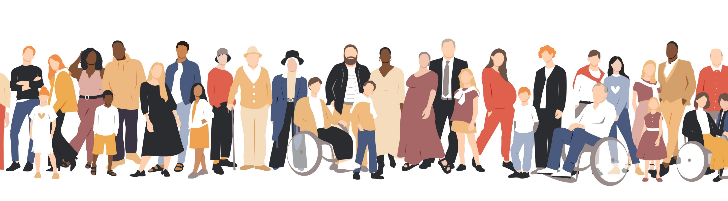
Healthy Brain Community Grants
Healthy Brain Initiative| October 15, 2024
health.state.mn.us

Slide 2
Tribal-State Relations Acknowledgement Statement
The​ State of Minnesota is home to eleven (11) federally recognized Indian Tribes with elected Tribal government officials.​ The State of Minnesota acknowledges and supports the unique status of the Minnesota Tribal Nations and their​ absolute right to existence, self-governance, and self-determination.​ The United States and the state of Minnesota have a unique relationship with federally recognized​ Indian Tribes, formed by the Constitution of the United States, treaties, statutes, case law, and agreements.​ The state of Minnesota and the Minnesota Tribal governments significantly benefit from working​ together, learning from one another, and partnering where possible.
The Minnesota Department of Health (MDH) recognizes, values, and celebrates the vibrant and unique relationship between the eleven Tribal Nations and the State of Minnesota. MDH believes that the partnerships formed, through a government-to-government relationship, with the eleven tribal nations will effectively address health disparities and lead to better health outcomes for all of Minnesota.

Slide 3
Announcements
Please stay on mute if you are not talking
Type any questions you have in the chat so we can capture it in the FAQ – All questions will be posted on the FAQ page.

Slide 4

Agenda
Welcome and Introductions
Healthy Brain Community Grants Request for Proposal
Questions
Healthy Brain Initiative Overview
Application Process and Instructions

Slide 5
Welcome
Introduce yourself in the chat:
  Name
  Role
  Organization/Affiliation
  What is your favorite community event?
Notes:
Favorite community events are ones with music, food and free stuff.

Slide 6
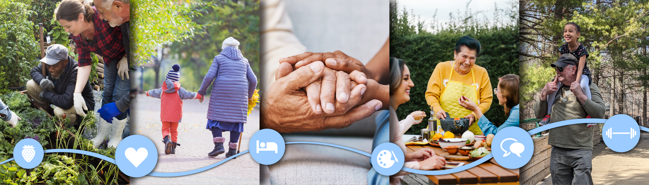
Minnesota Healthy Brain Initiative

Slide 7
MN Healthy Brain Initiative Overview
MN Department of Health’s Aging and Healthy Communities Unit
Minnesota Healthy Brain Initiative
  MDH initiative focused on Alzheimer’s disease and related dementias
  5-year CDC Funding for BOLD
    "Building our Largest Dementia" (BOLD) Infrastructure on Alzheimer's Act
  State Legislative Funding for Alzheimer’s Awareness Campaign
  Minnesota Dementia Strategic Plan
  Collaborate, convene, and connect with key partners working on dementia related work across that state

Slide 8

Minnesota Healthy Brain Initiative Goals
Goals
  Expanding efforts to prevent dementia by addressing risk factors that can be changed
  Improving detection and screening for dementia
  Ensuring people living with dementia have the support needed to live life fully and safely
  Enhancing support for dementia care partners (caregivers)

Slide 9

Minnesota Healthy Brain Initiative Activities
MN Healthy Brain Partnership
Partnerships with Volunteers of America and the MN Leadership Council on Aging
Healthy Brain Community Grants

Slide 10
Healthy Brain Community Grants Overview

Slide 11
2022-2025 Healthy Brain Community Grant RFP
Activities and Focus
  Educate and outreach: risk reduction, signs/symptoms, importance of early detection, dementia connections to other chronic diseases, brain health
    Screening of play and conversations
    Community events and health fairs
    Community forums, speakers, and conversations
    Evidenced-based Chronic Disease Management Education
  Connect to caregiver support/resources, encouraged follow up with health care providers
Fund 4 organizations at $20,000/year
  Total of $60,000 for each organization from Fall 2022 – Summer 2025

Slide 12
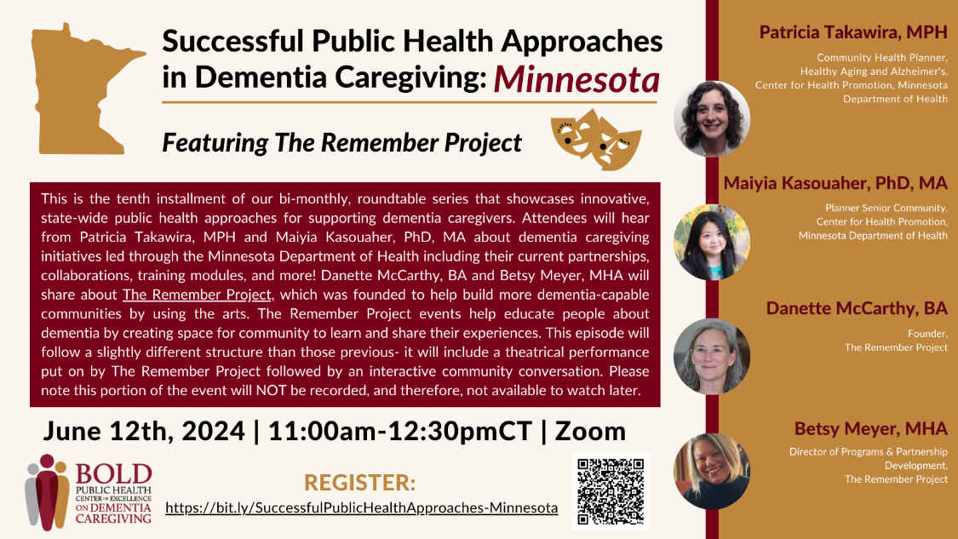
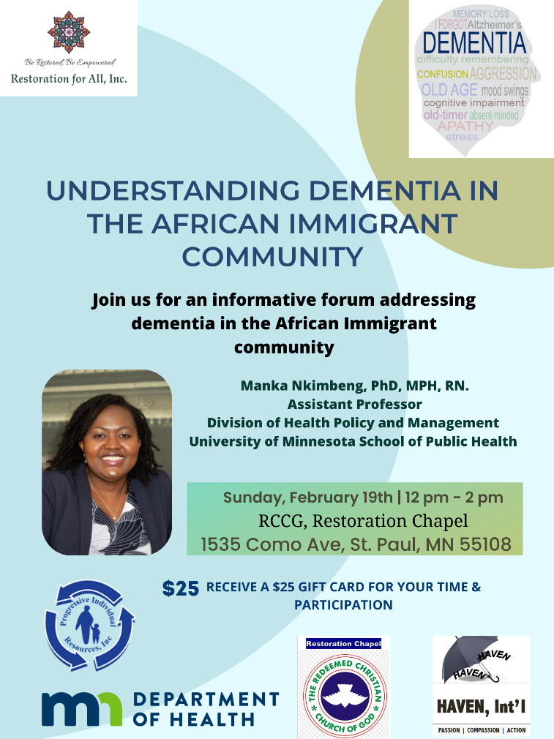
Examples of what our grantees are doing

Slide 13

Grant Request for Proposal Details

Slide 14
Timeline
11 Oct. 2024
Healthy Brain Community Grants Request for Proposal Release
15 Oct. 2024
Informational Session
12 Nov. 2024
Healthy Brain Community Grant Application Due
Dec. 2024
Notify Grantees
Mar. 2025 – Sep. 2028
Estimated Grant Period

Slide 15
2025-2028 Healthy Brain Community Grants Funding
Funding | Estimate
Estimated Amount of Total Funding Available | $240,000 for 3.5 years
Estimated Number of Awards | 1-4
Estimated Annual Award | $20,000 annually
Estimated Award Maximum for 3.5 years (depending on satisfactory grant performance and funding availability) | $60,000 /grantee

Slide 16
Eligibility
Eligible Applicants
  Community-based organizations
  Tribal governments
  Nonprofit organizations
  Faith-based organizations
  Social service organizations
  Clinics or healthcare organizations
  Community Health Boards/Local Public Health
  Local government
  Community Coalitions
We cannot fund research with this grant.
Organizations who have been funded in the past 2 years are not eligible to apply.
Notes:
Organizations or entities that do not have state or federal recognition can still apply by working with a fiscal agent. Applicants must be located in and conduct grant activities in the state of Minnesota, but fiscal agents may be located outside of Minnesota. Eligible applicants who wish to work together but have not formed a legal partnership may designate one organization as a fiscal agent.

Slide 17
Focus Population and Eligible Projects
This grant is focused on supporting populations affected by health inequities related to dementia, including BIPOC, LGBTQ+, American Indian, people living with disabilities, and communities in Greater Minnesota.
Risk Reduction Strategies
Early Diagnosis and Detection Strategies
Caregiver Support Strategies

Slide 18
What are we willing to fund?
Scope:
  Priority on focus populations
  Alignment with MN Dementia Strategic Plan, culturally responsive, community and geographically specific
  Education: dementia risk reduction, importance of early detection/diagnosis
  Support for people living with dementia and dementia care partners

Slide 19
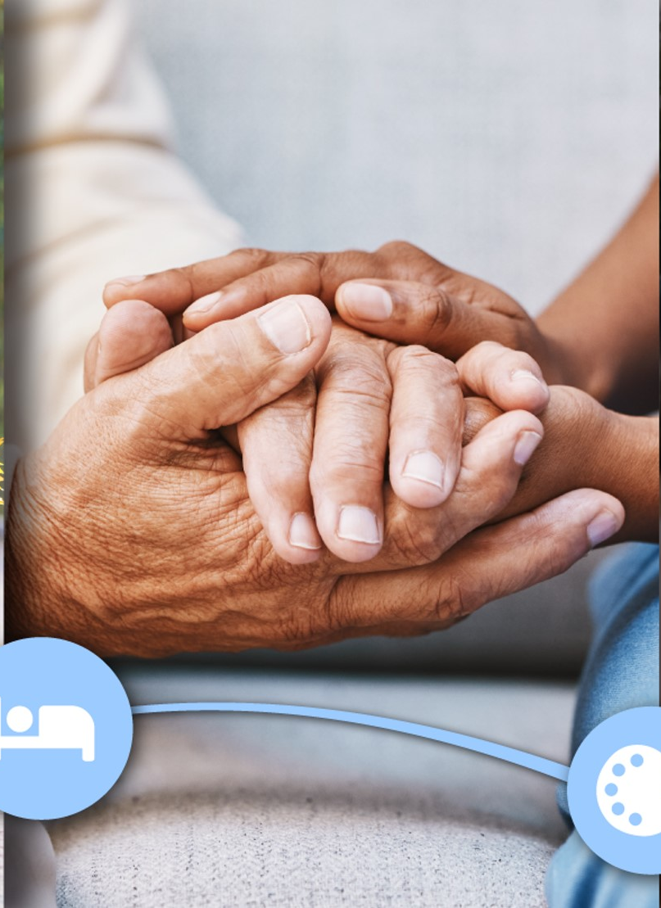
MN Dementia Strategic Plan
The plan is organized into four main areas:
Educate and Activate
Develop Policies and Partnerships
Ensure Culturally Responsive Care Teams
Accountability, Monitoring and Evaluation
MN Dementia Strategic Plan www.health.state.mn.us/diseases/alzheimers/docs/dementiaplan.pdf
Notes:
There are 4 domains in the MN Dementia Strategic Plan. These domains align with the CDC Healthy Brain RoadMap domains and actions.

Slide 20
Risk Reduction Strategies
Raise Awareness: Teach people about dementia, including what causes it, how early detection and diagnosis can help, and the importance of caregiver health and well-being.
  Example: Partner with trusted messengers to educate the community about uncontrolled high blood pressure as a risk factor for dementia
Reduce Stigma: Work with communities to create messages that address misinformation and provide an accurate understanding about dementia.
  Example: Partner with local community leaders and organizations to develop accurate, culturally and linguistically relevant messages about dementia risk, and find creative ways to share these messages with the community.

Slide 21
Early Detection and Diagnosis Strategies
Raise Awareness: Teach people about dementia, including what causes it, how early detection and diagnosis can help, and the importance of caregiver health and well-being.
  Example: Engage diverse rural communities to develop and disseminate messages about the importance of early detection and diagnosis.
Coordinate Resources: Promote and help people to use tools and resources that can prevent and detect dementia early and improve care.
  Example: Partner with key community organizations in the local area to create a central hub that connects care partners and people living with dementia to community-specific resources and services in Greater MN.

Slide 22
Caregiver Support Strategies
Offer Training: Create and share ongoing training and materials for people who care for those living with dementia.
  Example: Add free dementia curriculum to continuing education for all care team members including personal care assistants and community health workers.
Advance Shared Action: Unite communities and organizations to co-create and lead actions using culturally responsive language and practices that lower the risk of dementia, detect it earlier, and support the well-being of people with dementia and their caregivers.
  Example: Design creative social gatherings and connections that support care partners and people living with dementia at monthly luncheons and karaoke nights to increase and improve social community connections.

Slide 23
Community Engagement
Make sure your application describes how you engage the community you serve in shared decision-making.
• Co-creation of materials, health education, or initiatives
• Actively seeking feedback or guidance from the community the project aims to serve
• Gathering community members for listening sessions, forums, or planning purposes
• Engaging community members as leadership or guides for project scope
• Supporting outreach events or activities to excite, engage, or connect with community members
• Using community health assessments, surveys, or other existing community-developed resources to guide work

Slide 24
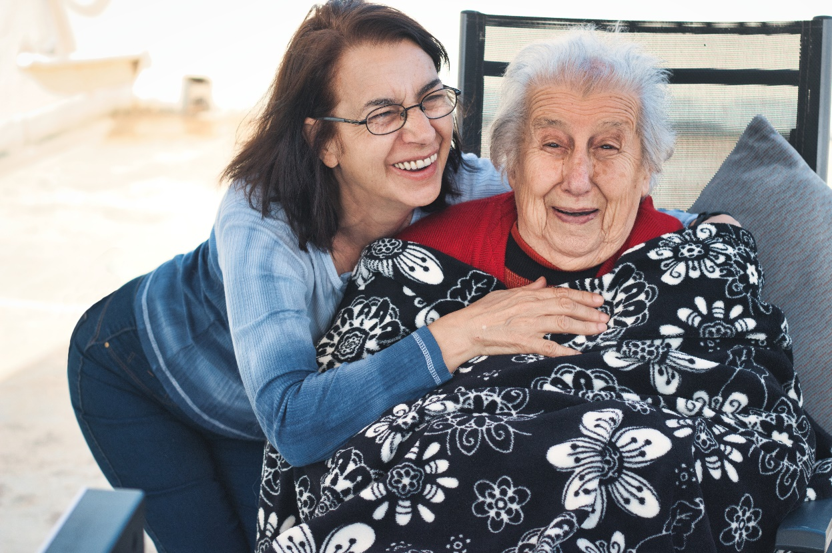
Grant Outcomes and Goals
Increase public knowledge about brain health, risk factors for dementia and benefits of early detection and diagnosis.
Increase knowledge and skills of current and future workforce.
Increase community partnerships.

Slide 25
Grantee Activities
Co-develop and finalize workplan
Designate primary liaison between MDH and organization
Submit reports
Final Report
Activity Tracker
Submit monthly invoices
Co-develop an evaluation plan
Mid-year Report

Slide 26
Technical Assistance
Workplan
Partnership Development
Budgeting
Invoicing
Evaluation Plan

Slide 27
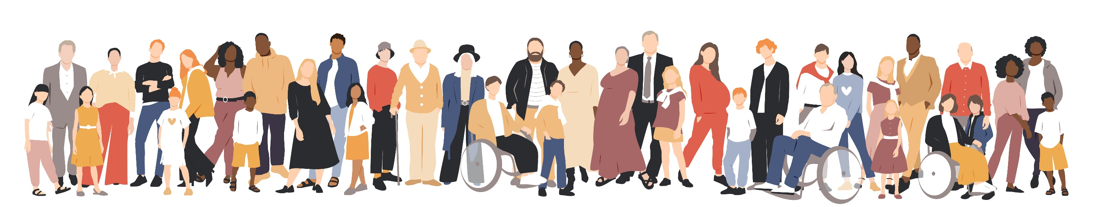
Application Process and Instructions

Slide 28
Application Section
You must submit all the following for your application to be considered complete:
Application Form-Attachment A (Microsoft Word Template)
Budget-Attachment C (Microsoft Excel Template)
Due Diligence Review Form-Attachment D (Use the form provided)
Conflict of Interest Disclosure Form-Attachment E (Use the form provided)

Slide 29
Application
Complete Sections A & B
  Section A: General Information, Project Information
  Section B: Application
    Applicant Profile
    Project Narrative and Community Engagement
    Project Alignment
    Expected Results and Measuring Success

Slide 30
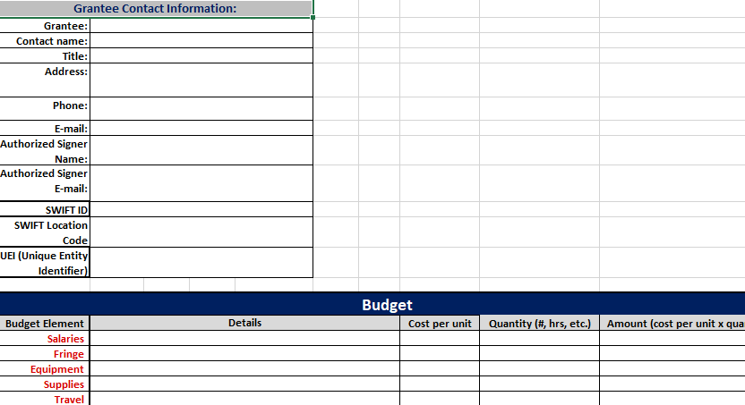
Budget

Slide 31
Application Submission Instructions
Submit via email to health.healthybrain@state.mn.us
Subject line: “Healthy Brain Community Grant Application – [lead organization name]”
Submit applications no later than Tuesday, November 12, 2024 at 11:59 p.m. CT
Please plan ahead and do not wait until the last minute to submit!

Slide 32
Application Review and Selection Process
Funding will be allocated through a competitive process with review by a committee representing content and community specialists with specific knowledge of and experience with brain health and related dementias, MDH staff, agency partners, and other state agency staff.
The review committee will evaluate all eligible and complete applications received by the deadline.

Slide 33
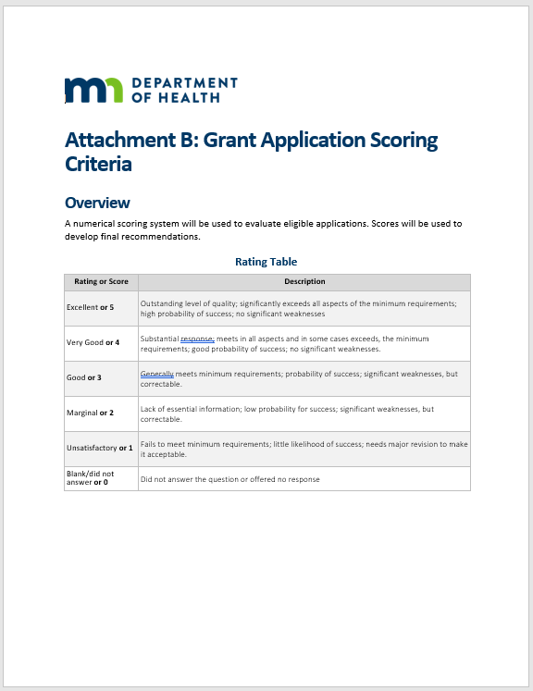
Application Scoring
All scoring information can be found on the website in Attachment B: Grant Application Scoring Criteria
Numerical scoring system out of 50 possible points
  Applicant Profile (5 pts)
  Project Narrative and Community Engagement (20 pts)
  Project Alignment (10 pts)
  Expected Results and Measuring Success (10 pts)
  Budget and Budget Justification (5 pts)
Please stay within the word limit for each section
Notes:
Applicants are strongly encouraged to score their own application prior to submitting

Slide 34
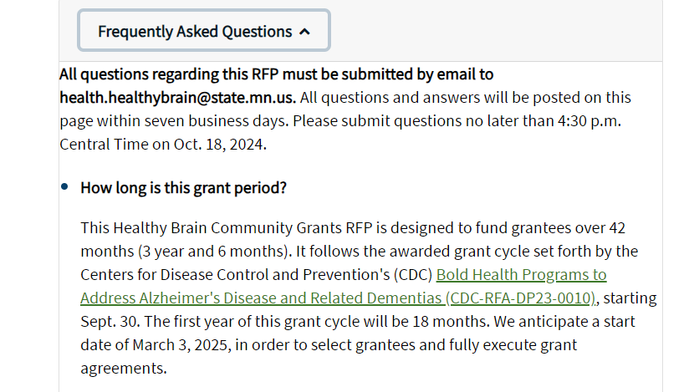
Find answers to your questions on the FAQ webpage
Healthy Brain Community Grants Frequently Asked Questions
https://www.health.state.mn.us/diseases/alzheimers/funding/index.html

Slide 35
Questions

Slide 36
Thank You!
Healthy Brain Initiative
Health.healthybrain@state.mn.us

