Slide 1
High Consequence Infectious Diseases (HCID)
Disease Specifics

Slide 2
High Consequence Infectious Diseases
Middle East Respiratory Syndrome (MERS)
Ebola Virus Disease (EVD)
Marburg hemorrhagic fever (Marburg HF)
Lassa Fever
Crimean-Congo Hemorrhagic Fever (CCHF)
Nipha Virus (NiV)
Monkeypox

Slide 3
Patient Screening
All patients should be screened for
  Respiratory symptoms
  Fever
  Rash
  Travel history in last 30 days
Screening all patients will aid in identifying a high consequence infectious disease (HCID) or other contagious illnesses such as measles, chickenpox, and influenza

Slide 4
HCID Definition
A high consequence infectious disease (HCID) is defined by the Minnesota HCID Collaborative* as a disease that:
All forms of medical waste are classified as Category A infectious substances (UN2814) by the U.S. Department of Transportation
or
Has potential to cause a high mortality among otherwise healthy people
and
  no routine vaccine exists
  and
    some types of direct clinical specimens pose generalized risks to laboratory personnel
    or
    risk of secondary airborne spread or unknown mode of transmission
MN HCID Collaborative: MN Department of Health, Mayo Clinic, University of Minnesota Medical Center, Minnesota Hospital Association, Minnesota Health Care Coalitions, Minnesota HCID-Ready EMS services

Slide 5
HCID For Which No Routine Vaccine is Currently Available
 |  |  | HCID for which no routine vaccine currently available
Syndrome | Pathogen Examples | Category A waste | Generalized laboratory risk from direct clinical specimens | Risk of airborne spread in healthcare settings or unknown mode of transmission
Unknown highly fatal disease with evidence of person-to-person spread |  | Yes | Yes | Yes
Hemorrhagic fever | Ebola virus, Marburg virus, Lassa virus, Crimean-Congo virus, Guanarito virus, Machupo virus, Junin virus, Sabia virus, Lujo virus, Chapare virus, Kayasnur Forest Disease, Omsk Hemorrhagic Fever, Hantaviruses causing HFRS | Yes | Yes | Yes/No (none are known to be transmitted via airborne spread, but all potential modes of transmission may be unknown for some rare pathogens)
Poxvirus diseases | Variola (smallpox) virus, Monkeypox | Yes | Yes | Yes
Febrile neurological or respiratory illness | Nipah virus, Hendra virus | Yes | ? | Yes (Nipah virus only)
Febrile respiratory illness | MERS-CoV, SARS-CoV, Pandemic Influenza | No | No | Yes

Slide 6
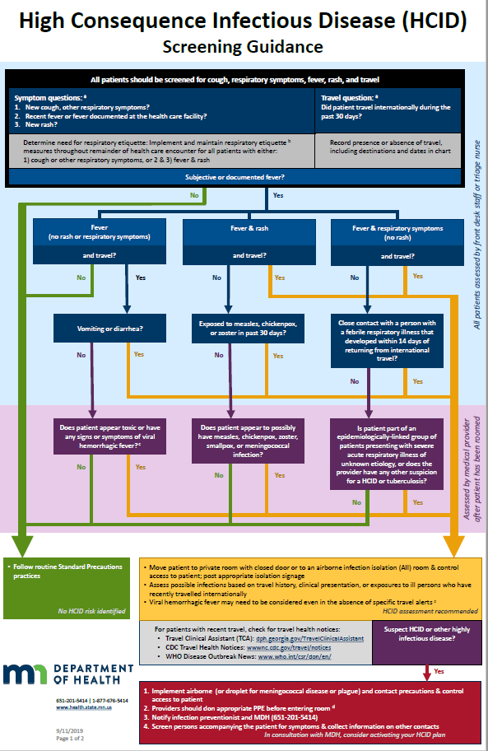
HCID Screening Guidance
A suggested framework to aid with the Identify, Isolate, and Inform components of HCID preparedness
Impact not limited to HCIDs; designed to prevent spread of both common and are rare infections
Emphasizes respiratory etiquette
4 short questions for all patients
1 additional question in some circumstances

Slide 7
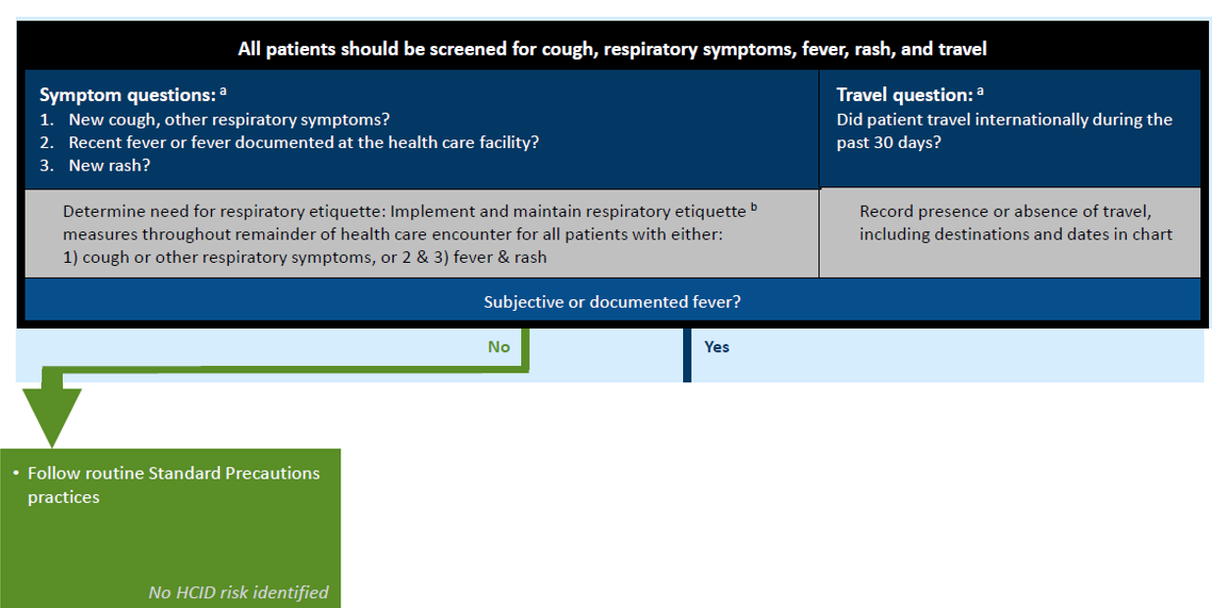
Assessed by Front Desk or Triage Nurse
Notes:
Screenshot is blown up to show:
All patients should be screened for cough, respiratory symptoms, fever, rash, and travel
Symptom questions: 1) New cough, other respiratory symptoms? 2) Recent fever or fever documented at the health care facility? 3) New rash?
This determines need for respiratory etiquette: Implement and maintain respiratory etiquette measures throughout remainder of health care encounter for all patients with either: 1) cough or other respiratory symptoms, or 2) and 3) fever and rash
If no subjective or documented fever, follow routine standard precautions practices; no HCID risk identified
Travel question: Did patient travel internationally during the past 30 days? Record presence or absence of travel, including destinations and dates in chart

Slide 8
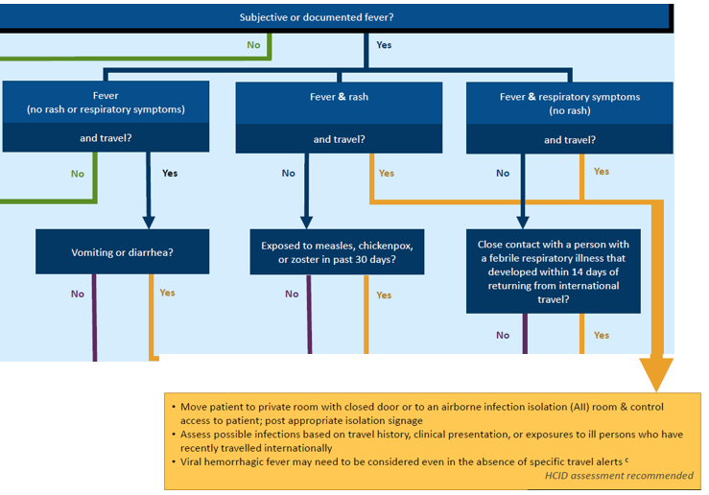
Assessed by Front Desk or Triage Nurse: Fever
Notes:
Moving through the assessment this part of the questionnaire shows how the front desk or triage nurse should assess patients with:
Fever (no rash or respiratory symptoms) and travel, then if there is vomiting or diarrhea
Fever and rash and travel, then if they were exposed to measles, chickenpox, or zoster in past 30 days
Fever and respiratory symptoms (no rash) and travel, then close contact with a person with febrile respiratory illness that developed within 14 days of returning from international travel
In cases of answering yes, the assessment instructs:
Move patient to private room with closed door or to an airborne infection isolation (All) room and control access to patient; post appropriate isolation signage
Assess possible infections based on travel history, clinical presentation, or exposures to ill person who have recently travelled internationally
Viral hemorrhagic fever may need to be considered even in the absence of specific travel alerts
HCID assessment recommended

Slide 9
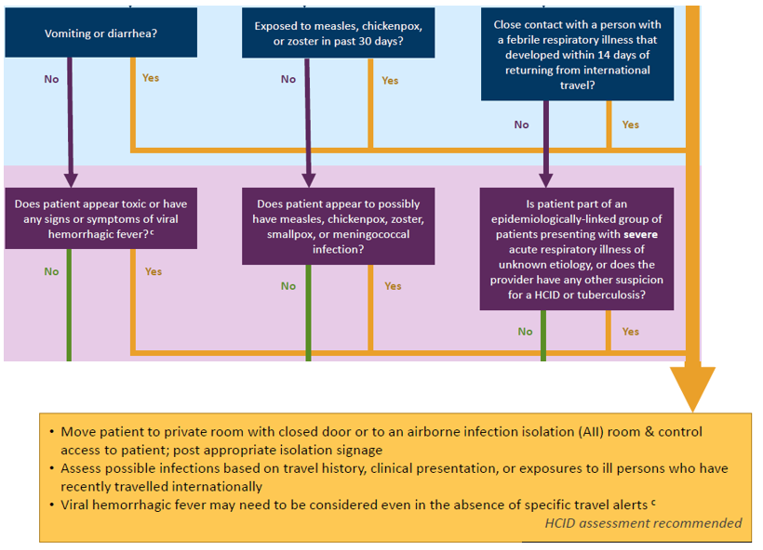
Assessed by Provider (purple and yellow areas)
Notes:
Moving through the assessment this part of the questionnaire shows how the provider should ask:
Does patient appear toxic or have any signs or symptoms of viral hemorrhagic fever?
Does patient appear to possibly have measles, chickenpox, zoster, smallpox, or meningococcal infection?
Is patient part of an epidemiologically-linked group of patients presenting with severe acute respiratory illness of unknown etiology, or does the provider have any other suspicion for a HCID or tuberculosis?
In cases of answering yes, the assessment instructs:
Move patient to private room with closed door or to an airborne infection isolation (All) room and control access to patient; post appropriate isolation signage
Assess possible infections based on travel history, clinical presentation, or exposures to ill person who have recently travelled internationally
Viral hemorrhagic fever may need to be considered even in the absence of specific travel alerts
HCID assessment recommended

Slide 10
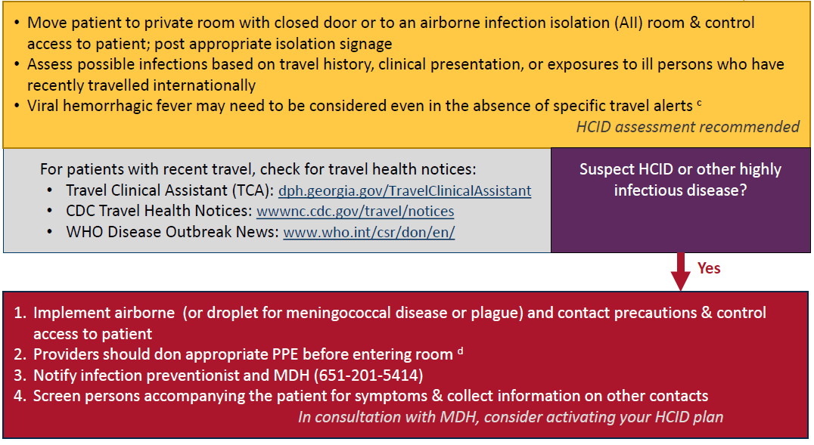
Assessed by Provider
Notes:
Move patient to private room with closed door or to an airborne infection isolation (All) room and control access to patient; post appropriate isolation signage
Assess possible infections based on travel history, clinical presentation, or exposures to ill person who have recently travelled internationally
Viral hemorrhagic fever may need to be considered even in the absence of specific travel alerts
HCID assessment recommended
For patients with recent travel, check for travel health notices:
Travel Clinical Assistant (TCA): dph.Georgia.gov/TravelClinicalAssistant
CDC Travel Health Notices: wwwnc.cdc.gov/travel/notices
WHO Disease Outbreak News: www.who.int/csr/don/en/
If the provider suspects HCID or other highly infectious disease, they should:
Implement airborne (or droplet for meningococcal disease or plague) and contact precautions and control access to patient
Providers should don appropriate PPE before entering room
Notify infection preventionist and MDH (651-201-5414)
Screen persons accompanying the patient for symptoms and collect information on other contacts
In consultation with MDH, consider activating your HCID plan.

Slide 11
If HCID suspected – do the following
Place appropriate isolation signage at the patient’s door
Evaluate persons accompanying the patient for illness and/or exposure to a HCID
Track all health care providers (HCP) who have had contact with the suspected HCID patient for potential exposure
Track all the HCP who have entered the patients room for potential exposure
Clinical staff should contact the laboratory leadership regarding sending specimens to the facility’s clinical laboratory

Slide 12
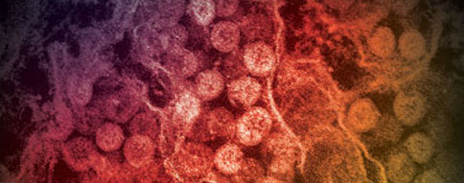
Middle East Respiratory Syndrome (MERS)
CDC: Middle East Respiratory Syndrome (MERS) (https://www.cdc.gov/coronavirus/mers/index.html)
WHO: Middle East respiratory syndrome coronavirus (MERS-CoV) (https://www.who.int/emergencies/mers-cov/en/)

Slide 13
History of MERS-CoV Infection
Middle East Respiratory Syndrome (MERS) is caused by a virus called Middle East Respiratory Syndrome Coronavirus (MERS-CoV). Most MERS patients develop severe acute respiratory illness with symptoms of fever, cough, and shortness of breath. About 3 to 4 out of every 10 patients reported with MERS have died.
Health officials first reported the disease in Saudi Arabia in September 2012. Through retrospective (backward-looking) investigations, health officials later identified that the first known cases of MERS occurred in Jordan in April 2012. So far, all cases of MERS have been linked through travel to, or residence in, countries in and near the Arabian Peninsula.
The largest known outbreak of MERS outside the Arabian Peninsula occurred in the Republic of Korea in 2015. The outbreak was associated with a traveler returning from the Arabian Peninsula. There was a total of 186 cases which occurred primarily due to transmission in health care facilities. The case fatality rate was 44%.¹
MERS-CoV has spread from ill people to others through close contact, such as caring for or living with an infected person.
¹ Park J, Lee K, Lee K, et al. Hospital Outbreaks of Middle East Respiratory Syndrome, Daejeon, South Korea, 2015. Emerg Infect Dis. 2017;23(6):898-905.

Slide 14
About Middle East Respiratory Syndrome (MERS)
Screen all patients for:
  Respiratory symptoms
  Fever
  Rash
  Travel history in last 30 days
  Screening all patients will aid in identifying an HCID or other contagious illnesses such as measles, chickenpox, and influenza
Symptoms
  Fever, cough, shortness of breath - may have diarrhea and nausea/vomiting, sore throat, coryza, headache, dizziness, abdominal pain
  In severe cases pneumonia and kidney failure
  Some have mild illness (like a cold) or no symptoms
  People with pre-existing conditions may be more likely to be infected or have a severe case
Causative agent
  Coronavirus called Middle East Respiratory Syndrome Coronavirus (MERS-CoV)

Slide 15
About MERS continued
Reservoir
  Humans and camels
  Source is likely an animal source in the Arabian Peninsula
Incubation period
  Usually about 5-6 days, but can range from 2-14 days
Transmission
  Close contact
  Thought to spread from an infected person’s respiratory secretions such as through coughing
  The precise ways the virus spreads are not currently well understood
Diagnosis
  For suspect case, contact MDH at 651-201-5414 or 1-877-676-5414
  MDH can perform testing for MERS-CoV
  Specimens for testing: lower respiratory specimen, NP swab and serum

Slide 16
MERS Management and Treatment
Lab Specimens
  Follow standard laboratory practices using Standard Precautions for potential MERS-CoV specimens
  Specimens are Category B per Department of Transportation. Must package appropriately for transport.
Management of contacts
  Identify persons at risk for contact with patient: staff, other patients, visitors
  Evaluate persons who accompany the patient for symptoms of MERS
  Develop plan with the state and federal authorities for monitoring exposed persons and facility staff
  Monitor exposed persons for 14 days for symptoms of MERS
Treatment
  There is no specific antiviral treatment recommended for MERS-CoV infection. Individuals with MERS often receive medical care to help relieve symptoms. For severe cases, current treatment includes care to support vital organ functions.

Slide 17
MERS Isolation Precautions
Isolation
Clinical symptoms and epidemiologic risk should be met to designate a patient under investigation (PUI) for MERS – CDC: MERS Interim Guidance for Healthcare Professionals (https://www.cdc.gov/coronavirus/mers/interim-guidance.html)
Place face mask (not N95) on any patient with respiratory symptoms
Place patient in airborne infection isolation room (AIIR) as soon as possible
Hand hygiene, personal protective equipment (PPE): gloves, gown, N95 or PAPR, eye protection
Identify others at risk for exposure (persons accompanying patient, other patients, visitors)
Limit transport of patient around facility
Only essential persons should enter room. Consider using phone or intercom for communication with patient.
Length of isolation determined on a case-by-case basis with consult from state and federal health authorities

Slide 18
MERS and Infection Prevention and Control
Cleaning
  Standard cleaning and disinfection procedures are appropriate for MERS-CoV in health care settings, including those patient-care areas in which aerosol-generating procedures are performed. If there are no available EPA-registered products that have a label claim for MERS-CoV, products with label claims against human coronaviruses should be used according to label instructions.
Waste
  Management of laundry, food service utensils, and medical waste should also be performed in accordance with routine procedures
Prevention
  No vaccine
  Protect from respiratory diseases in general: hand hygiene, respiratory etiquette

Slide 19
Patient Under Investigation (PUI) Definition MERS
Fever¹ AND pneumonia or acute respiratory distress syndrome (based on clinical or radiologic evidence) AND EITHER:
  history of travel from countries in or near the Arabian Peninsula² within 14 days before symptom onset, OR
  close contact³ with a symptomatic traveler who developed fever and acute respiratory illness (not necessarily pneumonia) within 14 days after traveling from countries in or near the Arabian Peninsula², OR
  a member of a cluster of patients with severe acute respiratory illness (e.g., fever¹ and pneumonia requiring hospitalization) of unknown etiology in which MERS-CoV is being evaluated, in consultation with state and local health departments,
  OR
Fever¹ AND symptoms of respiratory illness (not necessarily pneumonia; e.g., cough, shortness of breath) AND being in a healthcare facility (as a patient, worker, or visitor) within 14 days before symptom onset in a country or territory in or near the Arabian Peninsula² in which recent healthcare-associated cases of MERS have been identified.
OR
Fever¹ OR symptoms of respiratory illness (not necessarily pneumonia; e.g. cough, shortness of breath) AND close contact³ with a confirmed MERS case while the case was ill.
Footnotes are on subsequent slide

Slide 20
Confirmed and Probable Case Definition MERS-CoV
Confirmed Case
  A confirmed case is a person with laboratory confirmation of MERS-CoV infection. Confirmatory laboratory testing requires a positive PCR on at least two specific genomic targets or a single positive target with sequencing on a second.
Probable Case
  A probable case is a PUI with absent or inconclusive laboratory results for MERS-CoV infection who is a close contact³ of a laboratory-confirmed MERS-CoV case. Examples of laboratory results that may be considered inconclusive include a positive test on a single PCR target, a positive test with an assay that has limited performance data available, or a negative test on an inadequate specimen.
Footnotes are on subsequent slide

Slide 21
MERS PUI Definition Footnotes
Fever may not be present in some patients, such as those who are very young, elderly, immunosuppressed, or taking certain medications. Clinical judgement should be used to guide testing of patients in such situations.
Countries considered in the Arabian Peninsula and neighboring include: Bahrain; Iraq; Iran; Israel, the West Bank, and Gaza; Jordan; Kuwait; Lebanon; Oman; Qatar; Saudi Arabia; Syria; the United Arab Emirates (UAE); and Yemen.
Close contact is defined as a) being within approximately 6 feet (2 meters), or within the room or care area, of a confirmed MERS case for a prolonged period of time (such as caring for, living with, visiting, or sharing a healthcare waiting area or room with, a confirmed MERS case) while not wearing recommended personal protective equipment or PPE (e.g., gowns, gloves, NIOSH-certified disposable N95 respirator, eye protection); or b) having direct contact with infectious secretions of a confirmed MERS case (e.g., being coughed on) while not wearing recommended personal protective equipment.

Slide 22
Middle East Respiratory Syndrome Coronavirus (MERS-CoV) Overview
Disease & Agent | Geographic Areas | Transmission | Incubation period | Signs & Symptoms | Mortality rate | Diagnostic Testing | Prevention & Treatment | Isolation & PPE | Cleaning | Specimen transport and waste
Middle East Respiratory Syndrome (MERS) is caused by Middle East Respiratory Syndrome Coronavirus (MERS-CoV) | Linked to travel in and near the Arabian Peninsula 2015 Korean outbreak – traveler returning from the Arabian Peninsula Source is likely an animal source in the Arabian Peninsula | Close contact Thought to spread from an infected person’s respiratory secretions such as though coughing The precise ways the virus spreads are not currently well understood | Usually about 5-6 days but can range from 2-14 days | Fever, cough, shortness of breath - may have diarrhea and nausea/vomiting, sore throat, coryza, headache, dizziness, abdominal pain In severe cases can be followed by pneumonia and kidney failure Some have mild illness (like a cold) or no symptoms People with pre-existing conditions may be more likely to be infected or have a severe case | About 3 to 4 out of every 10 patients reported with MERS have died | Specimens for testing: lower respiratory specimen, NP swab and serum For suspect case, contact MDH at 651-201-5414 or 1-877-676-5414 MDH can perform testing for MERS-CoV | There is no specific antiviral treatment recommended for MERS-CoV infection Individuals with MERS often receive medical care to help relieve symptoms. For severe cases, current treatment includes care to support vital organ functions | Place facemask (not N95) on any patient with respiratory symptoms Place patient in airborne infection isolation room (AIIR) as soon as possible Hand hygiene, personal protective equipment (PPE): gloves, gown, N95 or PAPR), eye protection | Standard cleaning and disinfection procedures If available EPA -registered products do not have a label claim for MERS-CoV, products with label claims against human coronaviruses should be used according to label instructions | Transport specimens as Category B infectious waste Management of laundry, food service utensils, and medical waste should be performed in accordance with routine procedures
References:
CDC: Middle East Respiratory Syndrome (MERS) (https://www.cdc.gov/coronavirus/mers/index.html)
WHO: Middle East respiratory syndrome coronavirus (MERS-CoV) (https://www.who.int/emergencies/mers-cov/en/)

Slide 23
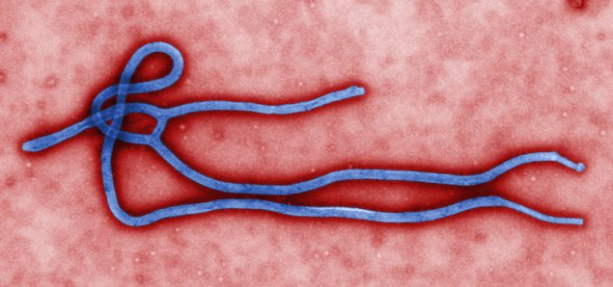
Ebola Virus Disease (EVD)
CDC: Ebola (Ebola Virus Disease) (https://www.cdc.gov/vhf/ebola/index.html)
WHO: Ebola virus disease (https://www.who.int/health-topics/ebola)

Slide 24
History of Ebola Virus Disease (EVD)
People probably initially infected with Ebola virus from an infected animal, such as a fruit bat or nonhuman primate. The virus then spreads person to person. Mortality rate may be as high as 50%.
EVD was discovered in 1976 when two consecutive outbreaks of fatal hemorrhagic fever occurred in different parts of Central Africa. The first outbreak occurred in the Democratic Republic of Congo (formerly Zaire) in a village near the Ebola River, which gave the virus its name.
Viral and epidemiologic data suggest that Ebola virus existed long before these recorded outbreaks occurred. Factors like population growth, encroachment into forested areas, and direct interaction with wildlife (such as bushmeat consumption) may have contributed to the spread of the Ebola virus.
Occurrences
  Since 1976, the virus has emerged periodically in several African countries
  2014-16 Guinea, Liberia, Sierra Leone - outbreak of 28,610 cases
  2018 Democratic Republic of Congo (formerly Zaire)

Slide 25
About Ebola Virus Disease (EVD)
Screen all patients for:
  Respiratory symptoms
  Fever
  Rash
  Travel history in last 30 days
  Screening all patients will aid in identifying an HCID or other contagious illnesses such as measles, chickenpox, and influenza
Symptoms
  Fever, severe headache, muscle pain, weakness, fatigue, diarrhea, vomiting, abdominal pain, unexplained hemorrhage, potential rash
  Lab findings may include leukopenia frequently with lymphopenia followed by elevated neutrophils and a left shift. Platelet counts often are decreased in the 50,000 to 100,000 range. Amylase and hepatic transaminases may be elevated
Causative agent
  Ebola virus – negative stranded RNA virus in the family of Filoviridae. Five Ebola virus species are known (Zaire, Sudan, Tai Forest, Bundibugyo, Reston) and 4 have been shown to cause human disease. Zaire is the species which has caused recent outbreaks in humans. Reston causes disease in nonhumans.

Slide 26
About Ebola Virus Disease (EVD) continued
Reservoir
  African fruit bats are likely involved in the spread of Ebola virus. Scientists continue to search for conclusive evidence of the bat’s role in transmission of Ebola.
Incubation period
  Symptoms may appear from 2-21 days after exposure with an average range of 8-10 days
Transmission
  Direct contact (to broken skin or mucous membranes in the eyes, nose, or mouth) with blood or body fluids of an ill person with EVD
  Ebola can remain in certain body fluids after a person has recovered from the infection. Semen, breast milk, ocular fluid, and spinal column fluid. Research is underway on this topic.
  There is no evidence that EVD is spread through mosquitoes or other insects

Slide 27
EVD Management and Treatment
Diagnosis – see subsequent slide for case definition
  For suspect case, contact MDH at 651-201-5414 or 1-877-676-5414
  MDH can perform testing for EVD from serum
Lab Specimens
  Specimens are Category A per Department of Transportation. Must package appropriately for transport.
Management of contacts
  Evaluate persons who accompany the patient for symptoms of EVD
  Identify and log persons potentially exposed to patient: staff, other patients, visitors and develop plan with the state and federal authorities for monitoring exposed persons and facility staff
  Monitor exposed persons for 21 days
Treatment
  No specific antiviral treatment. Some agents continued to be studied (e.g. ZMapp)

Slide 28
EVD Isolation Precautions
Isolation
Clinical symptoms and epidemiologic risk should be used to designate a person under investigation (PUI)
Place face mask (not N95) on any patient with respiratory symptoms
Place patient in private room. Airborne infection isolation room (AIIR) preferred. If no private bathroom use commode.
Post appropriate isolation signage. Level 1 or Level 2 Full Barrier Isolation.
Post personnel at door to ensure PPE is donned and doffed appropriately. Create a doffing area.
Dedicate medical equipment and remove all nonessential items from the room
Limit transport and perform minimum procedures and blood draws
Minimize or avoid aerosol generating procedures (BiPAP, bronchoscopy, sputum induction, intubation and extubation and open suctioning of airway); these procedures require Level 2 Full Barrier HCID PPE.
Hand hygiene, Level 1 personal protective equipment (PPE): gloves (2 pairs), gown, face mask, eye protection
Level 2 PPE required for any patient with vomiting, diarrhea, bleeding, or clinically unstable
Consider using phone or intercom for communication with patient

Slide 29
EVD Infection Prevention and Control
Persistence of the virus
  On dry surfaces, like doorknobs and countertops, the virus can survive for several hours
  In body fluids like blood, the virus can survive up to several days at room temperature
Cleaning
  Disinfection of Ebola virus should be done using a U.S. Environmental Protection Agency (EPA)-registered hospital disinfectant with a label claim for a non-enveloped virus. Although, Ebola is an enveloped virus and is easier to kill than non-enveloped viruses, as a precaution selection of a disinfectant product with a higher potency than what is normally required for an enveloped virus is being recommended at this time.
  See List L: EPA’s Registered Antimicrobial Products that Meet the CDC Criteria for Use Against the Ebola Virus (https://www.epa.gov/pesticide-registration/list-l-epas-registered-antimicrobial-products-meet-cdc-criteria-use-against)
Waste
  Is Category A infectious waste. Hold waste in the room of a Person Under Investigation (PUI) for EVD until ruled out. Consult with the MDH on management of the waste.
Prevention
  Vaccine trials are underway
  Protection from body fluids and contaminated environment of persons with EVD

Slide 30
Case Definitions for Ebola Virus Disease (EVD)
Current EVD risk factors: Contact with blood or bodily fluids of acutely ill persons with suspected or confirmed EVD such as:
providing care in a home or healthcare setting
participation in funeral rituals, including preparation of bodies for burial or touching a corpse at a traditional burial ceremony
working in a laboratory where human specimens are handled
handling wild animals or carcasses that may be infected with Ebola virus (primates, fruit bats, duikers)
sexual history, specifically if the patient has had contact with the semen from a man who has recovered from Ebola virus disease (for example, oral, vaginal, or anal sex).
Person Under Investigation (PUI)
A person who has both consistent signs or symptoms and risk factors as follows should be considered a PUI:
Elevated body temperature or subjective fever or symptoms, including severe headache, fatigue, muscle pain, vomiting, diarrhea, abdominal pain, or unexplained hemorrhage; AND
An epidemiologic risk factor (as listed above) within the 21 days before the onset of symptoms.
Confirmed Case
Laboratory-confirmed diagnostic evidence of Ebola virus infection

Slide 31
Personal Protective Equipment (PPE) for Evaluating
Clinically Stable PUIs for Ebola
Patient is clinically stable AND is not bleeding, vomiting, or having diarrhea, and does not require aerosol-generating procedures
Use Level 1 Full Barrier HCID PPE
Wear a single use (disposable):
  Fluid-resistant gown that extends to at least mid-calf or single-use (disposable) fluid-resistant coveralls without integrated hood (ANSI/AAMI Level 3)
  Disposable face mask
  Full face shield
  Gloves with extended cuffs. Two pairs of gloves should be worn. At a minimum, outer gloves should have extended cuffs.

Slide 32
Personal Protective Equipment (PPE) for Evaluating
Clinically Unstable PUIs for Ebola
Patient meets the definition of a Person Under Investigation (PUI) for Ebola and is exhibiting obvious bleeding, vomiting, or diarrhea;
Or is clinically unstable and/or will require invasive or aerosol-generating procedures (e.g., intubation, suctioning, active resuscitation)
Or is a person with confirmed Ebola
Use Level 2 Full Barrier HCID PPE
Cover all skin by wearing a single use (disposable):
Impermeable garment: gown or coverall (ANSI/AAMI Level 4)
N95 respirator or PAPR preferred (disinfect motor part of PAPR)
Gloves (2 pairs), at a minimum outer gloves should have extended cuffs
Boot covers
Apron

Slide 33
Ebola Virus Disease (EVD) Overview
Disease & Agent | Geographic areas | Transmission | Incubation period | Signs & Symptoms | Mortality rate | Diagnostic Testing | Prevention & Treatment | Isolation and PPE | Cleaning | Specimen transport and waste | Disease & Agent
Ebola virus – negative stranded RNA virus in the family of Filoviridae | Democratic Republic of Congo, Sudan, Cote D’Ivore, Gabon, Uganda, Republic of the Congo, Guinea, Liberia, Sierra Leonne | Probably initially from an infected animal such as a fruit bat Person to person through blood and body fluids Ebola can remain in semen, breast milk, ocular fluid, and spinal column fluid No evidence that EVD is spread through mosquitoes or other insects | Symptoms may appear from 2-21 days with an average range of 8-10 days | Fever, severe headache, muscle pain, weakness, fatigue, diarrhea, vomiting, abdominal pain, unexplained hemorrhage, potential rash Leukopenia frequently with lymphopenia followed by elevated neutrophils and a left shift. Platelet counts often are decreased in the 50,000 to 100,000 range. Amylase and hepatic transaminases may be elevated | May be as high as 50% | Consult with facility’s Lab Director before sending any specimens to the facility’s general lab For suspect case, contact MDH at 651-201-5414 or 1-877-676-5414 MDH can perform testing for EVD from serum | Vaccine trials are underway Protection from body fluids and environment of persons with EVD No specific antiviral treatment | Place facemask (not N95) on any patient with respiratory symptoms Airborne Infection Isolation Room Gloves 2 pairs, gown, N95 or PAPR, eye protection. Cover all skin if unstable patient, diarrhea, or bleeding | EPA registered hospital disinfectant on List L with a label claim for a non-enveloped virus. | Specimens are Category A per Department of Transportation Must package appropriately for transport Category A infectious waste. Hold waste in room until ruled in or out. MDH will assist with waste disposal. | Ebola virus – negative stranded RNA virus in the family of Filoviridae
References:
CDC: Ebola (Ebola Virus Disease) (https://www.cdc.gov/vhf/ebola/index.html)
WHO: Ebola virus disease (https://www.who.int/health-topics/ebola)

Slide 34
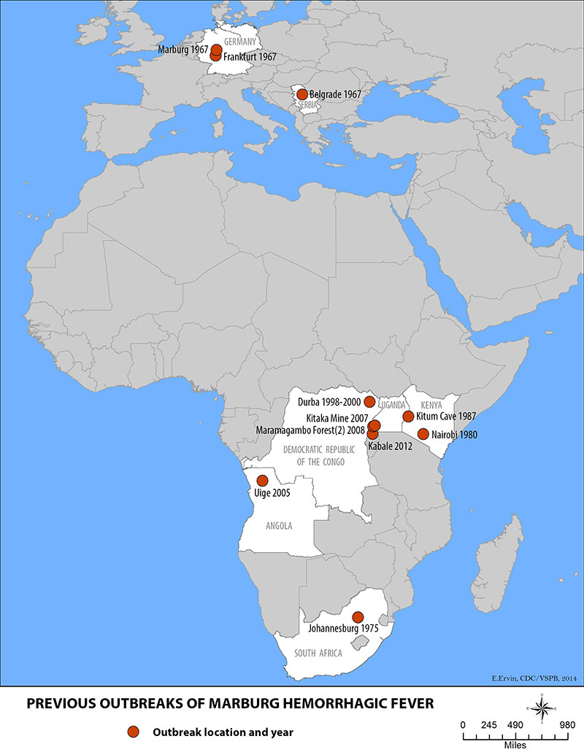
Marburg hemorrhagic fever (Marburg HF)
CDC: Marburg hemorrhagic fever (Marburg HF) (https://www.cdc.gov/vhf/marburg/index.html)
WHO: Marburg virus disease (https://www.who.int/csr/disease/marburg/en/)

Slide 35
History of Marburg hemorrhagic fever
Marburg virus was first recognized in 1967, when outbreaks of hemorrhagic fever occurred simultaneously in laboratories in Marburg and Frankfurt, Germany and in Belgrade, Yugoslavia (now Serbia). Thirty-one people became ill. They were laboratory workers followed by medical personnel and family members who had cared for them. Seven deaths were reported. The lab workers were exposed to imported African green monkeys or their tissues during research.
Outbreaks have started with mine workers in bat infested mines.
In 2012 there were 15 confirmed cases and 8 probable cases in Uganda. There were 15 deaths.
In 2008, U.S. and Dutch travelers who visited caves in Maramagambo Forest in Uganda (home to thousands of bats) acquired Marburg HF.
In 2005 there was an outbreak in Angola.
The case-fatality rate for Marburg hemorrhagic fever is between 23-90%.

Slide 36
About Marburg hemorrhagic fever (Marburg HF)
Screen all patients for:
  Respiratory symptoms
  Fever
  Rash
  Travel history in last 30 days
  Screening all patients will aid in identifying an HCID or other contagious illnesses such as measles, chickenpox, and influenza
Symptoms
  Symptom onset is sudden with fever, chills, headache, and myalgia. Around the fifth day after the onset of symptoms, a maculopapular rash, most prominent on the trunk (chest, back, stomach), may occur. Nausea, vomiting, chest pain, a sore throat, abdominal pain, and diarrhea may then appear. Symptoms become increasingly severe and can include jaundice, inflammation of the pancreas, severe weight loss, delirium, shock, liver failure, massive hemorrhaging, and multi-organ dysfunction.
Causative agent
  Marburg virus - a genetically unique zoonotic (or, animal-borne) RNA virus of the Filoviridae family

Slide 37
About Marburg HF continued
Reservoir
  The reservoir host of Marburg virus is the African fruit bat, Rousettus aegyptiacus. Fruit bats do not to show signs of illness. Primates (including humans) can become infected with Marburg virus, and develop serious disease with high mortality. The fruit bat has a wide distribution across Africa which increases the risk of outbreaks in Africa.
Incubation period
  5-10 days
Transmission
  It is unknown how Marburg virus first transmits from its animal host to humans. Two cases in tourists in Uganda in 2008 most likely had unprotected contact with infected bat feces or aerosols.
  Person-to-person transmission can occur with exposure to blood and body fluids and contaminated equipment
  Veterinarians and laboratory or quarantine facility workers who handle non-human primates from Africa, may also be at increased risk of exposure

Slide 38
Marburg HF Diagnosis, Isolation, and Management
Diagnosis
  Difficult due the non-specific symptoms. Fever and travel history are important.
  Consult with MDH. Call 651-201-4515 or 1-877-676-5414 for assistance.
  Antigen-capture enzyme-linked immunosorbent assay (ELISA) testing, polymerase chain reaction (PCR), and IgM-capture ELISA within a few days of symptom onset. Virus isolation may also be performed. IgG-capture ELISA is appropriate for testing persons later.
Lab Specimens
  Specimens are Category A per Department of Transportation. Must package appropriately for transport.
Isolation
  Airborne Infection Isolation Room
  Post appropriate isolation signage. Level 1 or Level 2 Full Barrier Isolation.
  Gloves (2 pairs), gown, N95 or PAPR, eye protection. Cover all skin if unstable patient, diarrhea, or bleeding.
Management of contacts
  Evaluate persons who accompany the patient for symptoms of EVD
  Identify and log persons potentially exposed to patient: staff, other patients, visitors and develop plan with the state and federal authorities for monitoring exposed persons and facility staff

Slide 39
Marburg HF Treatment and Infection Prevention
Treatment
  Supportive care
Cleaning
  Disinfection of Marburg virus should be done using a U.S. Environmental Protection Agency (EPA)-registered hospital disinfectant with a label claim for a non-enveloped virus. Although, Marburg is an enveloped virus and is easier to kill than non-enveloped viruses, as a precaution selection of a disinfectant product with a higher potency than what is normally required for an enveloped virus is being recommended at this time.
  See List L: EPA’s Registered Antimicrobial Products that Meet the CDC Criteria for Use Against the Ebola Virus (https://www.epa.gov/pesticide-registration/list-l-epas-registered-antimicrobial-products-meet-cdc-criteria-use-against)
Waste
  Is Category A infectious waste. Hold waste in the room of a suspect Marburg case until HCIDs are ruled out. Consult with the MDH on management of the waste.
Prevention
  Avoiding fruit bats
  Prevent contact with blood or body fluids and contaminated environment from case

Slide 40
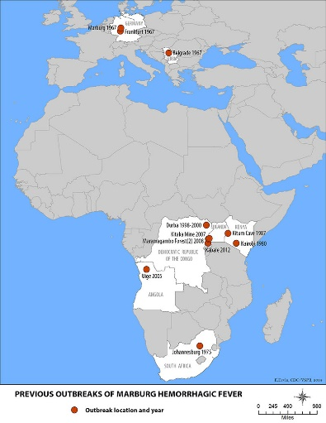
Marburg hemorrhagic fever Overview
Disease & Agent | Geographic areas | Transmission | Incubation period | Signs & Symptoms | Mortality rate | Diagnostic Testing | Prevention & Treatment | Isolation & PPE | Cleaning | Specimen transport and waste
Marburg virus - a genetically unique zoonotic (or, animal-borne) RNA virus of the Filoviridae family | Areas with fruit bats, especially caves or mines, in Uganda, Kenya, Democratic Republic of the Congo, Angola, South Africa. Outbreaks associated with imported African monkeys have occurred in Germany and Serbia | Unknown how Marburg virus first transmits from its animal host to humans but most likely unprotected contact with infected bat feces or aerosols Person-to-person transmission can occur with exposure to blood and body fluids and contaminated equipment | 5-10 days | Sudden onset with fever, chills, headache, and myalgia. Around day 5 a maculopapular rash, most prominent on the chest, back, stomach, may occur. Nausea, vomiting, chest pain, sore throat, abdominal pain, and diarrhea may then appear. Symptoms become increasingly severe and can include jaundice, inflammation of the pancreas, severe weight loss, delirium, shock, liver failure, massive hemorrhaging, and multi-organ dysfunction. | 23-90% | ELISA and PCR For suspect case, contact MDH at 651-201-5414 or 1-877-676-5414 | Avoid fruit bats and sick non-human primates in Africa Prevent contact with blood or body fluids and contaminated environment from case Supportive care | Place facemask (not N95) on any patient with respiratory symptoms Airborne Infection Isolation Room Gloves (2 pairs), gown, N95 or PAPR, eye protection. Cover all skin if unstable patient, diarrhea, or bleeding | EPA registered hospital disinfectant on List L with a label claim for a non-enveloped virus. | Category A specimens and waste
References:
CDC: Marburg hemorrhagic fever (Marburg HF) (https://www.cdc.gov/vhf/marburg/index.html)
WHO: Marburg virus disease (https://www.who.int/csr/disease/marburg/en/)

Slide 41
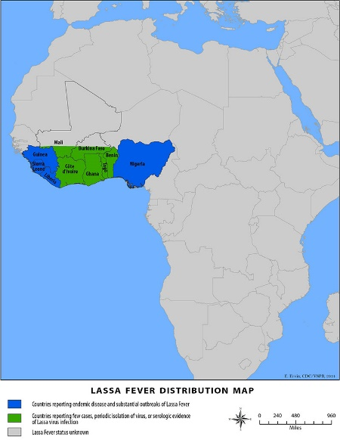
Lassa Fever
CDC: Lassa Fever
(https://www.cdc.gov/vhf/lassa/index.html)
WHO: Lassa fever
(https://www.who.int/health-topics/lassa-fever/)

Slide 42
History of Lassa Fever
Lassa fever is an acute viral illness that occurs in west Africa. Discovered in 1969 when two missionary nurses died in Nigeria. The virus is named after the town in Nigeria where the first cases occurred. Around 15-20% of patients hospitalized die. But overall, the death rate is about 1%. There is a 95% mortality in in fetuses of infected mothers
Lassa fever is endemic in parts of west Africa including Sierra Leone, Liberia, Guinea and Nigeria; however, other neighboring countries are also at risk, as the animal vector for Lassa virus, the "multimammate rat" (Mastomys natalensis) is distributed throughout the region. In 2009, the first case from Mali was reported in a traveler living in southern Mali; Ghana reported its first cases in late 2011. Isolated cases have also been reported in Côte d’Ivoire and Burkina Faso and there is serologic evidence of Lassa virus infection in Togo and Benin.
The number of Lassa virus infections per year in west Africa is estimated at 100,000 to 300,000, with approximately 5,000 deaths. These are crude estimates because surveillance for cases of the disease is not uniformly performed. In some areas of Sierra Leone and Liberia, it is known that 10%-16% of people admitted to hospitals every year have Lassa fever, which indicates the serious impact of the disease on the population of this region.

Slide 43
About Lassa Fever
Screen all patients for:
  Respiratory symptoms
  Fever
  Rash
  Travel history in last 30 days
  Screening all patients will aid in identifying an HCID or other contagious illnesses such as measles, chickenpox, and influenza
Symptoms
  Majority of Lassa infections (80%) are mild and undiagnosed.
  Fever, general malaise, weakness, headache. In 20% of infected individuals may progress to hemorrhaging (in gums, eyes, or nose, as examples), respiratory distress, repeated vomiting, facial swelling, pain in the chest, back, and abdomen, and shock. Hearing loss, tremors, and encephalitis. Death may occur within two weeks after symptom onset due to multi-organ failure.
Causative agent
  Lassa virus, a member of the virus family Arenaviridae, is a single-stranded RNA virus and is zoonotic, or animal-borne

Slide 44
About Lassa Fever continued
Reservoir
  The reservoir, or host, of Lassa virus is a rodent known as the "multimammate rat" (Mastomys natalensis)
Incubation period
  1-3 weeks
Transmission
  Contact with urine and feces of rats. Ingestion or inhalation of virus. Rats themselves are sometimes consumed as food.
  Can be spread from person to person via blood and body fluids or contaminated equipment
  Casual contact (including skin-to-skin contact without exchange of body fluids) does not spread Lassa virus
Diagnosis
  For suspect case, contact MDH at 651-201-5414 or 1-877-676-5414,
  Specimens for testing: serum
  Enzyme-linked immunosorbent serologic assays (ELISA), which detect IgM and IgG antibodies as well as Lassa antigen. Reverse transcription-polymerase chain reaction (RT-PCR) can be used in the early stage of disease. The virus itself may be cultured in 7 to 10 days.

Slide 45
Lassa Fever Isolation and Management
Lab Specimens
  Specimens are Category A per Department of Transportation. Must package appropriately for transport.
Isolation
  Place facemask (not N95) on any patient with respiratory symptoms
  Airborne Infection Isolation Room
  Post appropriate isolation signage. Level 1 or Level 2 Full Barrier Isolation.
  Gloves (2 pairs), gown, N95 or PAPR, eye protection. Cover all skin if unstable patient, diarrhea, or bleeding
Management of contacts
  Evaluate persons who accompany the patient for symptoms of EVD
  Identify and log persons potentially exposed to patient: staff, other patients, visitors and develop plan with the state and federal authorities for monitoring exposed persons and facility staff

Slide 46
Lassa Fever Treatment and Infection Prevention
Treatment
  Ribavirin, an antiviral drug, has been used with success along with supportive care
Cleaning
  Disinfection of Lassa virus should be done using a U.S. Environmental Protection Agency (EPA)-registered hospital disinfectant with a label claim for a non-enveloped virus. Although, Lassa is an enveloped virus and is easier to kill than non-enveloped viruses, as a precaution selection of a disinfectant product with a higher potency than what is normally required for an enveloped virus is being recommended at this time.
  See List L: EPA’s Registered Antimicrobial Products that Meet the CDC Criteria for Use Against the Ebola Virus (https://www.epa.gov/pesticide-registration/list-l-epas-registered-antimicrobial-products-meet-cdc-criteria-use-against)
Waste
  Is Category A infectious waste. Hold waste in the room of a suspect Lassa Fever case until HCIDs are ruled out. Consult with the MDH on management of the waste.
Prevention
  Avoid rat feces and urine
  Prevent contact with blood or body fluids from case

Slide 47
Lassa Fever Overview
Disease & Agent | Geographic area | Transmission | Incubation period | Signs & Symptoms | Mortality rate | Diagnostic Testing | Prevention & Treatment | Isolation & PPE | Cleaning | Specimen transport and waste
Lassa Fever Discovered in 1969 in Lassa, Nigeria. The virus, a member of the virus family Arenaviridaeis a single-stranded RNA virus and is zoonotic, or animal-borne. | Found in rural West Africa. Mainly in Sierra Leone, Liberia, Guinea, and Nigeria. Lassa virus infections per year in west Africa is estimated at 100,000 to 300,000, with approximately 5,000 deaths. | Contact with urine and feces of rats. Ingestion or inhalation of virus. Rats themselves are sometimes consumed as food. Can be spread from person to person via blood and body fluids or contaminated equipment. Casual contact (including skin-to-skin contact without exchange of body fluids) does not spread Lassa virus. | 1-3 weeks | Majority of Lassa infections (80%) are mild and undiagnosed. Fever, general malaise, weakness, headache. In 20% of infected individuals, may progress to hemorrhaging (in gums, eyes, or nose, as examples), respiratory distress, repeated vomiting, facial swelling, pain in the chest, back, and abdomen, and shock. Hearing loss, tremors, and encephalitis. Death may occur within two weeks after symptom onset due to multi-organ failure. | 15-20% of patients hospitalized die. But overall, the death rate is about 1%. 95% mortality in in fetuses of infected mothers. | Serum, ELISA IgM & IgG antibodies and Lassa antigen. RT PCR in early stage. Virus can be cultured by 7-10 days For suspect case, contact MDH at 651-201-5414 or 1-877-676-5414 | Avoid rat feces and urine. Ribavirin, an antiviral drug, has been used with success along with supportive care | Place facemask (not N95) on any patient with respiratory symptoms Airborne Infection Isolation Room Gloves (2 pairs), gown, N95 or PAPR, eye protection. Cover all skin if unstable patient, diarrhea, or bleeding | EPA registered hospital disinfectant on List L with a label claim for a non-enveloped virus. | Category A specimens and waste
References:
CDC: Lassa Fever (https://www.cdc.gov/vhf/lassa/index.html)
WHO: Lassa fever (https://www.who.int/health-topics/lassa-fever/)

Slide 48
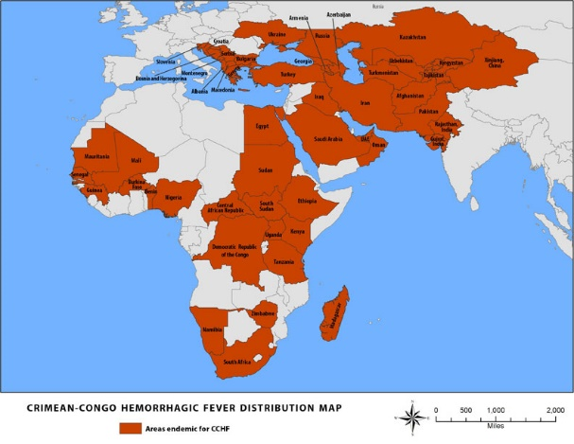
Crimean-Congo Hemorrhagic Fever Virus (CCHF)
CDC: Crimean-Congo Hemorrhagic Fever (CCHF) (https://www.cdc.gov/vhf/crimean-congo/index.html)
WHO: Crimean-Congo haemorrhagic fever (https://www.who.int/health-topics/crimean-congo-haemorrhagic-fever/)

Slide 49
History of Crimean-Congo Hemorrhagic Fever Virus
Crimean-Congo hemorrhagic fever (CCHF) is caused by infection with a tick-borne virus (Nairovirus) in the family Bunyaviridae. The disease was first characterized in the Crimea in 1944 and given the name Crimean hemorrhagic fever. It was then later recognized in 1969 as the cause of illness in the Congo, thus resulting in the current name of the disease.
Crimean-Congo hemorrhagic fever is found in Eastern Europe, particularly in the former Soviet Union, throughout the Mediterranean, in northwestern China, central Asia, southern Europe, Africa, the Middle East, and the Indian subcontinent.
In documented outbreaks of CCHF, fatality rates in hospitalized patients have ranged from 9% to as high as 50%.

Slide 50
About Crimean-Congo Hemorrhagic Fever Virus (CCHF)
Screen all patients for:
  Respiratory symptoms
  Fever
  Rash
  Travel history in last 30 days
  Screening all patients will aid in identifying an HCID or other contagious illnesses such as measles, chickenpox, and influenza
Symptoms
  Headache, high fever, back pain, joint pain, stomach pain, and vomiting. Red eyes, a flushed face, a red throat, and petechiae on the palate are common, jaundice. As illness progresses, large areas of severe bruising, severe nosebleeds, and uncontrolled bleeding at injection sites can be seen, beginning on about the fourth day of illness and lasting for about two weeks.
Causative agent
  Nairovirus in the family Bunyaviridae

Slide 51
About CCHF continued
Reservoir
  Ixodid (hard) ticks, especially those of the genus, Hyalomma, are both a reservoir and a vector. Wild and domestic animals, such as cattle, goats, sheep and hares, serve as amplifying hosts for the virus.
Incubation period
  1-3 days (max 9 days) after tick exposure
  5-6 days (max 13 days) after blood or body fluid exposure
Transmission
  To humans through contact with infected ticks or animal blood/fluids
  Can be transmitted person to person through blood and body fluids and improperly sterilized instruments
Diagnosis
  For suspect case, contact MDH at 651-201-5414 or 1-877-676-5414
  Specimens for testing: serology and tissue
  Enzyme-linked immunosorbent assay (ELISA); antigen detection; serum neutralization; reverse transcriptase polymerase chain reaction (RT-PCR) assay; and virus isolation by cell culture

Slide 52
CCHF Isolation and Management
Lab Specimens
  Specimens are Category A per Department of Transportation. Must package appropriately for transport.
Isolation
  Place facemask (not N95) on any patient with respiratory symptoms
  Airborne Infection Isolation Room
  Post appropriate isolation signage. Level 1 or Level 2 Full Barrier Isolation.
  Gloves (2 pairs), gown, N95 or PAPR, eye protection. Cover all skin if unstable patient, diarrhea, or bleeding
Management of contacts
  Evaluate persons who accompany the patient for symptoms of EVD
  Identify and log persons potentially exposed to patient: staff, other patients, visitors and develop plan with the state and federal authorities for monitoring exposed persons and facility staff

Slide 53
CCHF Treatment and Infection Prevention
Treatment
  No safe and effective vaccine yet
  Supportive care
Cleaning
  Disinfection of CCHF virus should be done using a U.S. Environmental Protection Agency (EPA)-registered hospital disinfectant with a label claim for a non-enveloped virus. Although, CCHF is an enveloped virus and is easier to kill than non-enveloped viruses, as a precaution selection of a disinfectant product with a higher potency than what is normally required for an enveloped virus is being recommended at this time.
  See List L: EPA’s Registered Antimicrobial Products that Meet the CDC Criteria for Use Against the Ebola Virus (https://www.epa.gov/pesticide-registration/list-l-epas-registered-antimicrobial-products-meet-cdc-criteria-use-against)
Waste
  Is Category A infectious waste. Hold waste in the room of a suspect Crimean-Congo Hemorrhagic Fever case until HCIDs ruled out. Consult with the MDH on management of the waste.
Prevention
  Prevent tick bites
  Prevent contact with blood or body fluids infected animals or from human case

Slide 54

Crimean-Congo Hemorrhagic Fever Virus (CCHF) Overview
Disease & Agent | Geographic areas | Transmission | Incubation period | Signs & Symptoms | Mortality rate | Diagnostic Testing | Prevention & Treatment | Isolation & PPE | Cleaning | Specimen transport and waste
Crimean Congo Hemorrhagic fever Nairovirus in the family Bunyaviridae Discovered 1944 | Eastern Europe, in former Soviet Union, Mediterranean, northwest China, central Asia, south Europe (including recent report from Spain), Africa, Middle East, Indian subcontinent | Ixodid (hard) ticks. Person to person – blood & body fluids Animals can act as amplifying hosts Animal herders, livestock and slaughterhouse workers, healthcare workers Transmission due to improper sterilization of medical equipment has occurred | 1-3 days (max 9 days) after tick exposure 5-6 days (max 13 days) after blood or body fluid exposure | Headache, high fever, back pain, joint pain, stomach pain, and vomiting. Red eyes, a flushed face, a red throat, and petechiae on the palate are common. Jaundice and mood and sensory perception can occur. As illness progresses, large areas of severe bruising, severe nosebleeds, and uncontrolled bleeding at injection sites can be seen, beginning on about the fourth day of illness and lasting for about two weeks. | 9-50% | Serology and tissue ELIZA and PCR Consult with facility’s Lab Director before sending any specimens to the facility’s general lab | Prevent tick bites Prevent contact with blood or body fluids from case No safe and effective vaccine Supportive care | Place facemask (not N95) on any patient with respiratory symptoms Airborne Infection Isolation Room Gloves (2 pairs), gown, N95 or PAPR, eye protection. Cover all skin if unstable patient, diarrhea, or bleeding | EPA registered hospital disinfectant on List L with a label claim for a non-enveloped virus. | Category A specimens and waste
References:
CDC: Crimean-Congo Hemorrhagic Fever (CCHF) (https://www.cdc.gov/vhf/crimean-congo/index.html)
WHO: Crimean-Congo haemorrhagic fever (https://www.who.int/health-topics/crimean-congo-haemorrhagic-fever/)

Slide 55
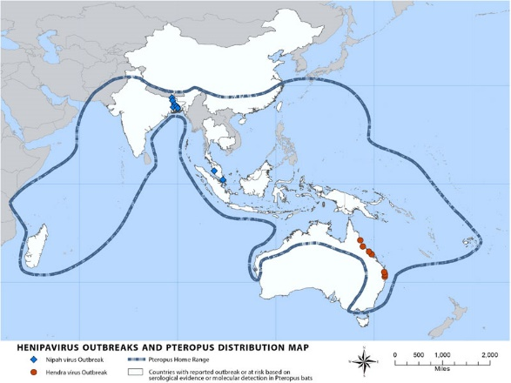
Nipah Virus (NiV)
CDC: Nipah Virus (NiV) (https://www.cdc.gov/vhf/nipah/index.html)
WHO: Nipah virus infection (https://www.who.int/csr/disease/nipah/en/)

Slide 56
History of Nipah Virus (NiV)
Nipah virus (NiV) was initially isolated and identified in 1999 during an outbreak of encephalitis and respiratory illness among pig farmers and people with close contact with pigs in Malaysia and Singapore.
Its name originated from Sungai Nipah, a village in the Malaysian Peninsula where pig farmers became ill with encephalitis. The case fatality rate is from 40% to 75%.
Given the relatedness of NiV to Hendra virus, bat species were quickly singled out for investigation and flying foxes of the genus Pteropus were subsequently identified as the reservoir for NiV.
In the 1999 outbreak, Nipah virus caused a relatively mild disease in pigs, but nearly 300 human cases with over 100 deaths were reported. In order to stop the outbreak, more than a million pigs were euthanized, causing tremendous trade loss for Malaysia. Since this outbreak, no subsequent cases (in neither swine nor human) have been reported in either Malaysia or Singapore.
In 2001, NiV was again identified as the causative agent in an outbreak of human disease occurring in Bangladesh. Genetic sequencing confirmed this virus as Nipah virus, but a strain different from the one identified in 1999. In the same year, another outbreak was identified retrospectively in Siliguri, India with reports of person-to-person transmission in hospital settings (nosocomial transmission). Unlike the Malaysian NiV outbreak, outbreaks occur almost annually in Bangladesh and have been reported several times in India, most recently in 2018 in the Indian state of Kerala.

Slide 57
About Nipah Virus (NiV)
Screen all patients for:
  Respiratory symptoms
  Fever
  Rash
  Travel history in last 30 days
  Screening all patients will aid in identifying an HCID or other contagious illnesses such as measles, chickenpox, and influenza
Symptoms
  Fever and headache, followed by drowsiness, disorientation and mental confusion.
  Can progress to coma within 24-48 hours. Some have a respiratory illness early and half of the patients show severe neurological and pulmonary signs.
  Long term issues include convulsions and personality changes.
Causative agent
  Nipah virus (NiV) is a member of the family Paramyxoviridae, genus Henipavirus

Slide 58
About NiV continued
Reservoir
  Infected bats, infected pigs, NiV infected people.
Incubation period
  5-14 days
  Latent infections with reactivation months to years have been reported
Transmission
  Transmission of Nipah virus to humans may occur after direct contact with infected bats, infected pigs
  Can be spread from person to person via blood and body fluids
Diagnosis
  Real time polymerase chain reaction (RT-PCR) from throat and nasal swabs, cerebrospinal fluid, urine, and blood
  ELISA (IgG and IgM) can be used later on.
  For suspect case, contact MDH at 651-201-5414 or 1-877-676-5414

Slide 59
NiV Isolation and Management
Lab Specimens
  Specimens are Category A per Department of Transportation. Must package appropriately for transport.
Isolation
  Place facemask (not N95) on any patient with respiratory symptoms
  Airborne Infection Isolation Room
  Post appropriate isolation signage. Level 1 or Level 2 Full Barrier Isolation.
  Gloves (2 pairs), gown, N95 or PAPR, eye protection
Management of contacts
  Evaluate persons who accompany the patient for symptoms of EVD
  Identify and log persons potentially exposed to patient: staff, other patients, visitors and develop plan with the state and federal authorities for monitoring exposed persons and facility staff

Slide 60
NiV Treatment and Infection Prevention
Treatment
  Supportive care
Cleaning
  Disinfection of Nipah virus should be done using a U.S. Environmental Protection Agency (EPA)-registered hospital disinfectant with a label claim for a non-enveloped virus. Although, Nipah is an enveloped virus and is easier to kill than non-enveloped viruses, as a precaution selection of a disinfectant product with a higher potency than what is normally required for an enveloped virus is being recommended at this time.
  List L: EPA’s Registered Antimicrobial Products that Meet the CDC Criteria for Use Against the Ebola Virus (https://www.epa.gov/pesticide-registration/list-l-epas-registered-antimicrobial-products-meet-cdc-criteria-use-against)
Waste
  Is Category A infectious waste. Hold waste in the room of a suspect Nipah case until HCIDs ruled out. Consult with the MDH on management of the waste.
Prevention
  Vaccine in development
  Avoid exposure to sick pigs and bats in endemic areas. Avoid drinking raw date palm sap.
  Prevent contact with blood or body fluids from case or contact with contaminated environment

Slide 61

Nipah Virus (NiV) Overview
Disease & Agent | Geographic areas | Transmission | Incubation period | Signs & Symptoms | Mortality rate | Diagnostic Testing | Prevention & Treatment | Isolation & PPE | Cleaning | Specimen transport and waste
Nipah virus (NiV) is a member of the family Paramyxoviridae, genus Henipavirus | Madagascar, India, Malaysia, Singapore. The true geographic range may be larger based on the home range of Pteropus bats (see map) | Transmission of Nipah virus to humans may occur after direct contact with infected bats, infected pigs, or from other NiV infected people In 1999 outbreak in Malaysia and Singapore, a relatively mild disease in pigs, but 300 human cases with 100 deaths. In 2001 outbreak in India saw person-to-person transmission in healthcare workers | 5-14 days Latent infections with reactivation months to years have been reported | Fever and headache, followed by drowsiness, disorientation and mental confusion. Can progress to coma within 24-48 hours. Some have a respiratory illness early and half of the patients show severe neurological and pulmonary signs Long term issues include convulsions and personality changes | Can be as high as 40-75% In the outbreak in 1998-99, 265 patients were infected with the virus. 40% of patients entering the hospitals with serious nervous disease died from the illness | RT-PCR from throat and nasal swabs, cerebrospinal fluid, urine, and blood. ELISA (IgG and IgM) can be used later into the illness For suspect case, contact MDH at 651-201-5414 or 1-877-676-5414 | Vaccine in development Avoid exposure to sick pigs and bats in endemic areas. Avoid drinking raw date palm sap. Supportive care | Place facemask (not N95) on any patient with respiratory symptoms Airborne Infection Isolation Room Gloves, gown, N95 or PAPR, eye protection. | EPA registered hospital disinfectant on List L with a label claim for a non-enveloped virus. | Category A specimens and waste
References:
CDC: Nipah Virus (NiV) (https://www.cdc.gov/vhf/nipah/index.html)
WHO: Nipah virus infection (https://www.who.int/csr/disease/nipah/en/)

Slide 62
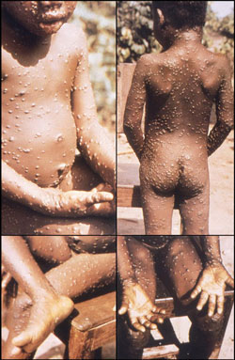
Monkeypox
CDC: Monkeypox (www.cdc.gov/poxvirus/monkeypox/index.html)
WHO: Human Monkeypox (MPX) (https://www.who.int/emergencies/diseases/monkeypox/en/)

Slide 63
History of Monkeypox
Monkeypox is a rare disease caused by infection with the monkeypox virus.
First discovered in 1958 when two outbreaks of a pox-like disease occurred in colonies of monkeys kept for research, hence the name ‘monkeypox.’ First human case of monkeypox was recorded in 1970 in the Democratic Republic of Congo during a period of intensified effort to eliminate smallpox. Since then monkeypox has been reported in other central and western African countries. A 2003 outbreak in the U.S. is the only time monkeypox infections in humans have been documented outside of Africa.
There are two distinct genetic groups (clades) of monkeypox virus. Central African and West African. West African monkeypox is associated with milder disease, fewer deaths, and less person-to-person transmission.
The natural monkeypox reservoir remains unknown. African rodent species likely play a role.
The 2003 U.S. outbreak of monkeypox occurred when a shipment of rodents from Ghana in west Africa, infected prairie dogs that were sold for pets. There were forty-seven confirmed or probable cases of reported from six states—Illinois, Indiana, Kansas, Missouri, Ohio, and Wisconsin.
In Africa, monkeypox has been shown to cause death in 1 in 10 persons who contract the disease.

Slide 64
About Monkeypox
Screen all patients for:
  Respiratory symptoms
  Fever
  Rash
  Travel history in last 30 days
  Screening all patients will aid in identifying an HCID or other contagious illnesses such as measles, chickenpox, and influenza
Symptoms
  Symptoms of monkeypox are similar to but milder than the symptoms of smallpox. Monkeypox begins with fever, headache, muscle aches, and exhaustion. The main difference between symptoms of smallpox and monkeypox is that monkeypox causes lymph nodes to swell (lymphadenopathy) while smallpox does not.
  Within 1 to 3 days (sometimes longer) after the appearance of fever, the patient develops a rash, often beginning on the face then spreading to other parts of the body. Lesions progress through the following stages before falling off: Macules, papules, vesicles, pustules, scabs
  The illness typically lasts for 2−4 weeks

Slide 65
About Monkeypox continued
Causative agent
  Monkeypox virus belongs to the Orthopoxvirus genus in the family Poxviridae. The Orthopoxvirus genus also includes variola virus (the cause of smallpox), vaccinia virus (used in the smallpox vaccine), and cowpox virus.
Reservoir
  Reservoir host (main disease carrier) of monkeypox is still unknown although African rodents are suspected to play a part in transmission
Incubation period
  Incubation period (time from infection to symptoms) is usually 7−14 days but can range from 5−21 days

Slide 66
Monkeypox Transmission
Transmission
  Transmission of monkeypox virus occurs when a person comes into contact with the virus from an animal, human, or materials contaminated with the virus. The virus enters the body through broken skin (even if not visible), respiratory tract, or the mucous membranes (eyes, nose, or mouth). Animal-to-human transmission may occur by bite or scratch, bush meat preparation, direct contact with body fluids or lesion material, or indirect contact with lesion material, such as through contaminated bedding.
  Person-to-person transmission is thought to occur primarily through large respiratory droplets. Respiratory droplets generally cannot travel more than a few feet, so prolonged face-to-face contact is required. Other person-to-person methods of transmission include direct contact with body fluids or lesion material, and indirect contact with lesion material, such as through contaminated clothing or linens.

Slide 67
Monkeypox Diagnosis
Diagnosis
  For suspect case, contact MDH for testing at 651-201-5414 or 1-877-676-5414
  Specimens for testing by phase of illness:
    Prodrome: tonsillar tissue swab, nasopharyngeal swab, acute serum and whole blood
    Rash: more than one lesion should be sampled from different locations on the body and different looking lesions
      Macules or Papules: tonsillar tissue swab, lesion biopsy, acute serum and whole blood
      Vesicles or Pustules: Lesion fluid, roof, or biopsy, electron microscopy grid, acute serum and whole blood
      Scabs or crusts: lesion scab or crust, acute serum and whole blood
    Post rash: convalescent serum
Lab Specimens
  For suspect case, contact MDH at 651-201-5414 or 1-877-676-5414
  Specimens are Category A per Department of Transportation. Must package appropriately for transport.

Slide 68
Monkeypox Isolation and Management
Isolation & PPE
  Place facemask (not N95) on any patient with respiratory symptoms
  Place patient in private room. Airborne infection isolation room (AIIR) preferred. If no private bathroom use commode.
  Cover patient’s skin lesions with sheet or gown
  Post appropriate isolation signage. Level 1 or Level 2 Full Barrier Isolation.
  Hand hygiene, personal protective equipment (PPE): gloves (2 pairs), gown, N95 or PAPR, eye protection
  Post personnel at door to ensure PPE is donned and doffed appropriately. Doff and dispose of all PPE before leaving isolation room.
  Dedicate medical equipment and remove all nonessential items from the room
Management of Contacts
  Evaluate people accompanying patient for symptoms. Give them a separate waiting area if possible.
  Identify and log persons potentially exposed to patient: staff, other patients, visitors and develop plan with the state and federal authorities for monitoring exposed persons and facility staff

Slide 69
Monkeypox Treatment and Infection Prevention
Treatment
  No specific treatments. Outbreaks can be controlled with Smallpox vaccine, Cidofovir or Brincidofovir, ST-246, and vaccinia immune globulin (VIG).
Cleaning
  Any EPA-registered hospital disinfectant currently used by healthcare facilities for environmental sanitation may be used. Follow the manufacturer’s instructions for concentration and contact time.
Waste
  Is Category A infectious waste. Hold waste in the room of a suspect monkeypox case until ruled in or out. Consult with the MDH on management of the waste.
Prevention
  Avoid contact with animals that could harbor the virus (including animals that are sick or that have been found dead in areas where monkeypox occurs)
  Avoid contact with any materials, such as bedding, that has been in contact with a sick animal
  Practice good hand hygiene after contact with infected animals or humans
  Proper personal protective equipment (PPE) when caring for patients

Slide 70
Monkeypox Overview
Disease & Agent | Risk areas | Transmission | Incubation period | Signs & Symptoms | Mortality rate | Diagnostic Testing | Prevention & Treatment | Isolation and PPE | Cleaning | Specimen transport and waste
Monkeypox virus belongs to the Orthopoxvirus genus in the family Poxviridae | Forested regions of West and Central Africa. Monkeypox is endemic in the Democratic Republic of the Congo (DRC), and occurs sporadically in neighboring countries (Republic of the Congo, Central African Republic, Sudan) | Transmission occurs when a person comes into contact with the virus from an animal, human, or contaminated materials. Virus enters the body through broken skin (even if not visible), respiratory tract, or mucous membranes. Human-to-human transmission is thought to occur primarily through large respiratory droplets and direct contact with body fluids or lesion material. | 7−14 days but can range from 5−21 days. | Begins with fever, headache, muscle aches, and exhaustion, lymphadenopathy. In 1-3 days, a rash develops usually beginning on the face then spreading. Lesions progressing through the following stages: Macules, papules, vesicles, pustules, scabs. typically lasts for 2−4 weeks. | 1 in 10 in Africa | For suspect case, contact MDH at 651-201-5414 or 1-877-676-5414 Specimens for testing vary by phase of illness and skin lesion type | Avoid exposure to infected animals or people. No specific treatments but outbreaks can be controlled with Smallpox vaccine, cidofovir, ST-246, and vaccinia immune globulin (VIG). | Cover patient’s skin lesions with sheet or gown Airborne Infection Isolation Room Gloves, gown, N95 or PAPR, eye protection. Cover all skin if unstable patient, diarrhea, or bleeding | EPA-registered hospital disinfectant Follow the manufacturer’s instructions for concentration, contact time | Specimens are Category A per Department of Transportation. Must package appropriately for transport. Category A infectious waste. Hold waste in room until ruled in or out. MDH will assist with waste disposal.
References:
CDC: Monkeypox (www.cdc.gov/poxvirus/monkeypox/index.html)
WHO: Human Monkeypox (MPX) (https://www.who.int/emergencies/diseases/monkeypox/en/)

